Slide 1
AfiAct II 发情监测II

Slide 2
Agenda内容
Why a farmer needs AfiAct II?
为什么牧场主需要二代发情监测？
Why a dealer want to sell AfiAct II?
为什么代理商想出售二代发情监测？
AfiAct II benefits
二代发情监测的优势？

Slide 3
Need to Improve Fertility Performance 需要提高繁殖绩效
How to increase the pregnancy rate and reduce the overall fertility cost per cow?
怎样提高受胎率降低每头牛繁殖成本？
=
$$Fertility Performance = Saving Money$$
繁殖绩效=节省成本
Notes:
After all it’s all about the bottom line and performance, with around $5 a day cost for open days it’s even more crucial today to get cows pregnant as early as we can
总之-所有都是关于底线和绩效，空怀天数每天的成本大概是5$，当下更重要的是尽早使牛怀孕

Slide 4
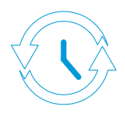
AfiAct II Saves Money for Farmers 二代发情监测可以为农场主节省成本
Comparing various breeding protocols
和多种育种规程对比
AfiAct II instead of visual observation
二代发情监测可替代人工观察发情
Ovsync with AfiMilk vs. Ovsync with Timed AI
阿菲金同期发情VS.人工定时同期发情
Open cow before pregnancy check
妊检前确定未受孕的牛
AfiAct II instead of Ovsync
二代发情监测替代同期发情
Notes:
AfiAct instead of visual observation二代发情监测可替代人工观察发情
Detect 35-45% more heats监测到多余35-45%的发情
Decrease of 20-25 days open减少20-25天的空怀天数
Ovsync + AfiMilk versus Ovsync with Timed AI阿菲金同期发情VS.人工定时同期发情
Detecting early lactation heats (pre-sync program)检测泌乳初期发情（同期发情之间）
Detecting open cows before pregnancy check妊检前监测到未受孕的牛只
Breeding cycle is reduced by 20-30 days减少20-30天的繁殖周期
Calculation:效果统计
Breeding cycle is reduced by 22 days缩短22天的繁殖周期
Assuming conception rate of 35%假设35%的受胎率
Assuming open day cost = $5假设空怀时每天的成本=5$
30 open days less per cow per lactation 每头牛每个胎次少30天的空怀天数
65% of cows require 2nd service65%的牛需要二次输精
42% of cows require 3rd service42%的牛需要三次输精
27% of cows require 4th service24%需要四次输精
In total, 1.35 X 22 = 30 open days 1.35*22=30天空怀天数
Total saving in open days = $150空怀期共计节省150$
AfiAct instead of Ovsync
Synch programs are expensive
Cost of Ovsync
Drugs = $18
Injection = $12

Slide 5
AfiAct II - Automatic Heat detection 二代发情监测-自动发情监测
Improving fertility performance改善繁殖绩效
节省人工
每头牛每个胎次减少
20-30天空怀天数
减少治疗
减少激素使用
预期可节省成本100—150$
投资回报率1-2年
Notes:
Explain the automatic heat detection advantages and saving
Labor saving:解释自动发情监测的优势及节省人工：
No need for visual labor无需人工观察发情
Meet the cow only once and not more只需见牛一次无需第二次

Slide 6
Customer Testimonial客户推荐
“…with AfiMilk we are able to do a lot better job breeding our cows.”使用阿菲金我们的奶牛繁殖工作可以做得更好
says Brian Houin from Homestead Dairy (Indiana, USA), whose herd has over a 28% pregnancy rate来自美国印第安纳州Brian Houin，全群超过28%受胎率

Slide 7
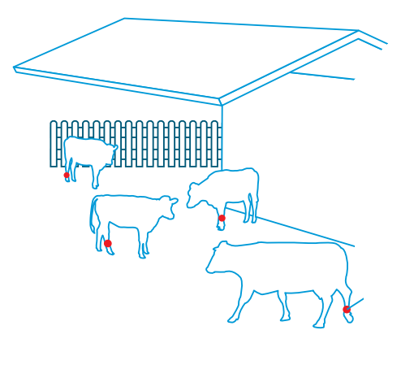
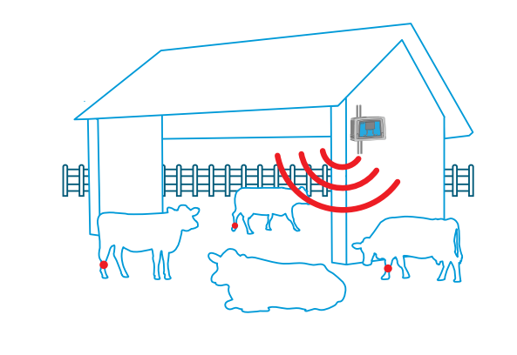
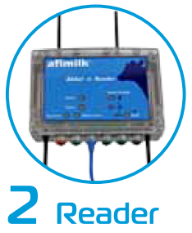
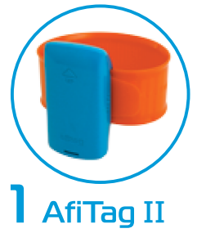
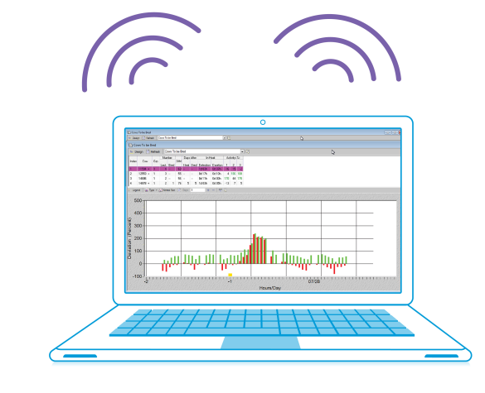
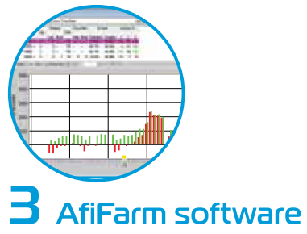
AfiAct II - A profitable offering 二代发情监测-一个盈利的产品
The dealer side代理商的角度
Long distance tag reading计步器长距离识别
Off-the-shelf Wi-Fi router牛舍无线路由器
No need for network cabling无需专门的网络布线
Short, simple and easy installation短安装少，简单&容易
Notes:
Long distance reading长距离读取数据
No need to change the yard – create special passages.无需更换牛舍-设置专门的通道

Slide 8
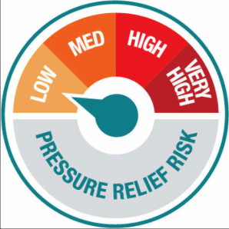
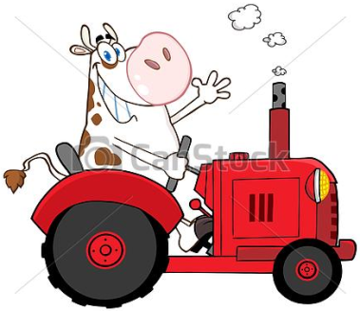
AfiAct II - A profitable offering 二代发情监测-一个盈利的产品
Because it is a good product to sell for the dealer
对代理商而言它是一个优质的产品
May be sold to customers
with different brands and systems
出售给客户的可能是不同的牌子和系统
Low risk (compare to milking parlor)
低风险（和奶厅相比）
Ensures a Happy customer确保客户满意
Notes:
The system is a key for new farms (foot in the door way).

Slide 9
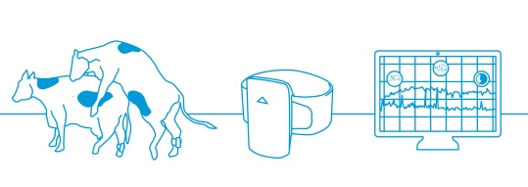
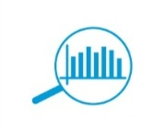
AfiAct II – benefits二代发情监测的优势
The highly scalable, adaptable system高效，适应性强的系统
Highest heat detection rate, lowest rate of false alerts
发情监测率最高，错误率最低
Accessible from the Web on any type of device
smartphone, tablet and laptop
通过网络可连接多种设备：智能手机，平板电脑本
Collects behavior and rest data anywhere on the farm:在牧场各处可收集所有数据
Wellbeing and health indication奶牛福利和健康指标
Notes:
Rest data:其他数据
Regular routine 10-12 hours常规程序10-12个小时
Wellbeing and comfort indication福利和舒适度指标
Rest behavior changes when cow has health issues休息行为的变化表明白奶牛健康出现问题

Slide 10
Report and graph报告和图表
“Cows to be bred”输精的奶牛
Notes:
This is the “Cow to be bred” report and graph. The “in heat” information leads to a better breeding timing.
这是需要输精的奶牛报告和图表，发情信息可提供最佳的输精时间

Slide 11
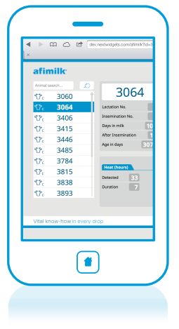
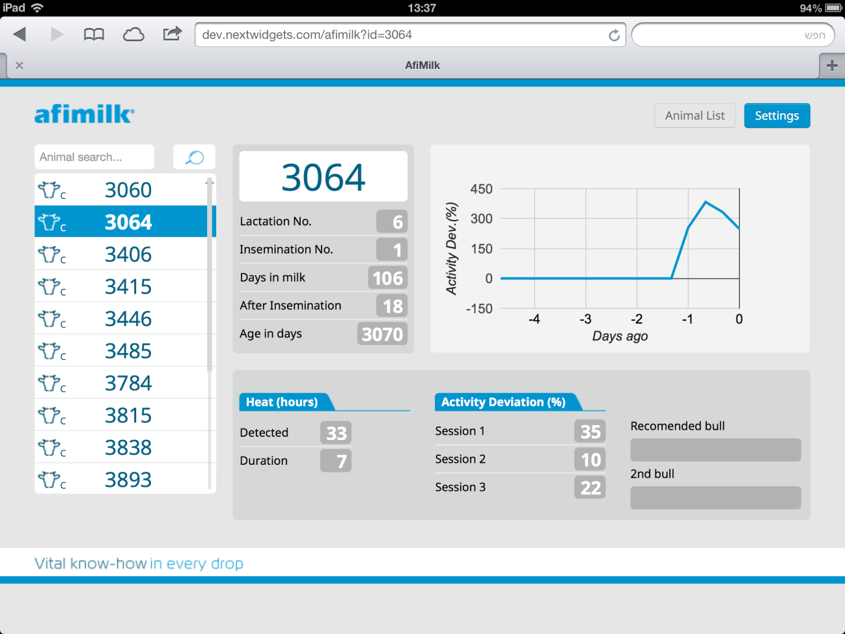
AfiAct II – Remote web access 二代发情监测-远程进入
Cows “In Heat” report发情报告
Via web on PC and smartphones通过网络使用OC和智能手机
SMS and email notifications SMS和邮件通知

Slide 12
Customer Testimonial客户推荐
“The AfiAct II system is a very good system, I am finding it very helpful and successful at getting pregnancies on my farm.” 阿菲金二代发情监测是一个非常好的系统，我发现它非常有用而且可以成功使奶牛受孕
says Tim Ottewell, Shottlegate Farm (De Laval Parlor), Derbyshire, UK英国Tim Ottwell，Shottlegate牧场（利拉伐奶厅）

Slide 13
AfiAct II阿菲金二代发情监测
The next-generation solution for heat detection
发情监测新产品
Promised results for the farmer
承诺牧场主
A good product to sell for the dealer
推荐给代理商出售的优质产品
A good way for increasing turnover
提高利润的一个好途径
二代发情监测
监测奶牛发情
其他系统就不可以

